Slide 1

Programming fundamentals
Get a Pen, This is helpful

Slide 2
Definitions
Lets get some things straight
Program: As a verb, program or programming is a term used to describe
the process of a programmer developing a software program.
Programmer: the guys that show up at 9 to jack up your day and get
Paid pretty well to do so
Automation: Any systematic application which combines multiple tasks
into a single action
The majority of the automation in the world exists to program, programs
Or to automate testing of programs made by humans
Ever used excel and entered a formula?
How about 2 formulas?
Congrats you are an automation programmer

Slide 3
Definitions- Programming General
Syntax: The specified manner that code is constructed to allow the compiler to interpret it Specifically the symbols and arrangement of text for a given language
Class – is a container of code that describes the various properties that all describe the class https://www.youtube.com/watch?v=yBs0ic7pVvk
Object: is the instantiation of a class
Property: is the data that represents the object.
Method: the instructions that make the object do a thing
Namespace – Container of objects that can be addressed

Slide 4
Definitions- Programming General #2
Variable- is a placeholder that represents some data. Usually must be specified for what type of data
codebabes
Data Type - a specified construct as part of the IDE to tell the compiler what the data is and rules for how it can be handled.
Construct- portion of the program that is reserved for some purpose

Slide 5
Any Questions
Of course not yall got this.

Slide 6
PLC Stuff Finally
Fundamentals for Structured Text

Slide 7
More Definitions.. But for PLC / SCADA
Inputs and Outputs– ALL programs have inputs and outputs, every computer program or function
relies on input data and output data
In automation programming we almost always use inputs and outputs as references for the
physical connections to field devices.
INPUTS TO THE PLC COME FROM OUTPUTS IN THE FIELD
INPUTS IN THE FIELD ARE TRIGGERED FROM OUTPUTS AT THE PLC
Analog - of, relating to, or being a mechanism or device in which information is represented by
continuously variable physical quantities.
2: Not Computerized: something not of a digital representation
Discrete – is essentially a Digital in /out. Its an on or off bool value. There is an explanation for
the engineering term discrete and you should know it…. But not now
Drive = AFD or VFD.
PID – Proportional, Integral, Derivative control.. Acute control of a process using an algebraic
method

Slide 8
More Definitions.. But for PLC / SCADA
PID – Proportional, Integral, Derivative control.. Acute control of a process using an algebraic
method
PV - Process variable, the condition that is the goal of a control scheme
CV- the controlled variable.
i.e. car speed is the Process variable we are controlling. The SP is the speed we are
the PV against to determine error. Then angle of the gas pedal in relation to the floor is the
CV. The what do you change to affect the PV
4-20 (as in Milliamps) – when someone says this, they really mean “Analog Signal” or Current Loop
Its real convenient that 4 and 20 are usual values for a current loop…

Slide 9
Last Ones
HMI -

Slide 10

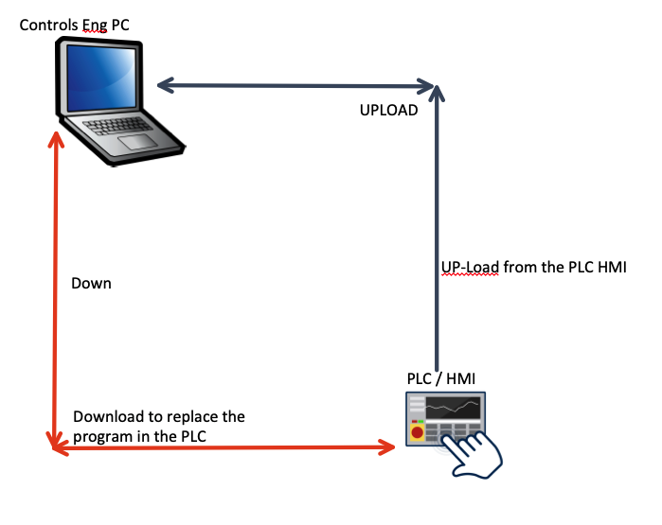
Please keep this in mind
A.D.D. thought
Upload = FROM PLC
Uploading – Taking a PLC Program from the PLC Memory to the Engineers
Download – Writing the PLC program from the engineers PC to the controller

Slide 11
NOT COMPLETE SLIDES
Statements
Expressions
Arithmetic Operators
Relational Operators
Logical Operators
Bitwise Operators
Instructions
Conditional
Iterative
execution control

Slide 12
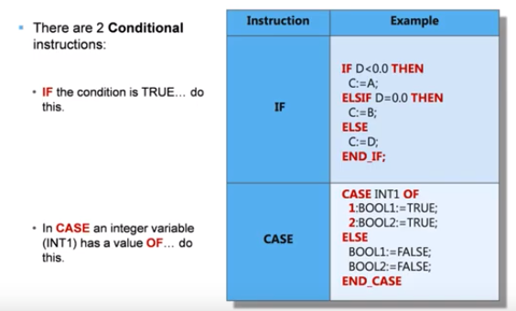
So you know what Automation is, and you got you a black hoodie.

Slide 13
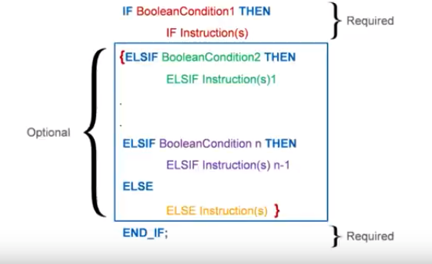
If BOOL is conditional that
When met will execute the
Instructions, and none other
This has a very clear impact
On how IF statements must
Be formulated

